Slide 1
Model-based Integrated Planning and Control of Autonomous Vehicles using Artificial Potential Fields with uncertain environment
Emilio Benenati
Josyula Viswanath Das
24th September 2021

Slide 2
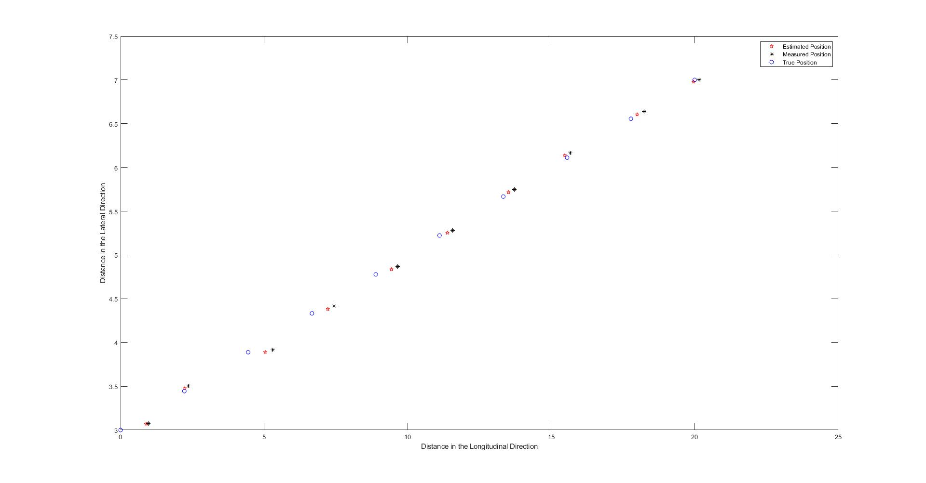
Filtered state

Slide 3
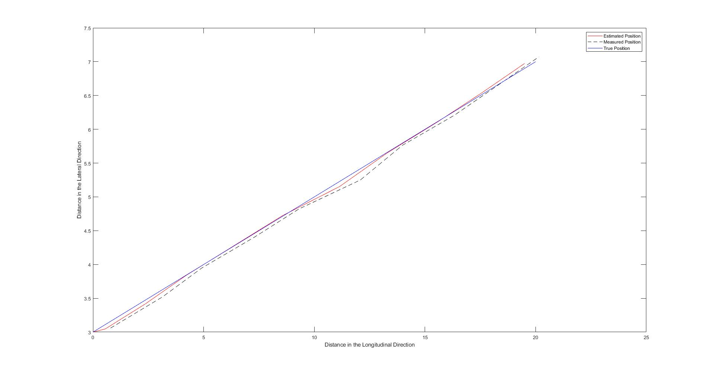
Filtered state

